Slide 1
NodeJS and React
Robert Kulesza

Slide 2
What This Presentation will Cover
NodeJS Installation
Setup NodeJS Project
Setup React Project
Setup Server
Write / Run in NodeJS
Write / Run React Application

Slide 3
NodeJS Installation
Windows, Mac
Download Installer from: https://nodejs.org/en/download/
Linux
Sudo apt-get install nodejs
Suggested
Download pm2 package – npm install pm2
Pm2 manages nodeJS processes
convenient for managing multiple NodeJS projects running at the same time

Slide 4
Setup NodeJS project
Create root directory for app /example123
Create /example123/index.js
In the file, write: console.log(“Hello World”);
Terminal:
npm init
node index.js | node .
Helpful
Typing in node in terminal opens the NodeJS interpreter

Slide 5
Setup React project
Terminal:
npx create-react-app client

Slide 6
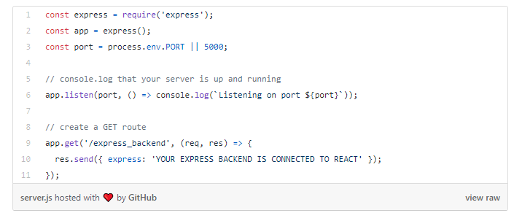
Setup Server (1)
Create /example123/server.js
Terminal:
npm install express –save
Write /example123/server.js

Slide 7
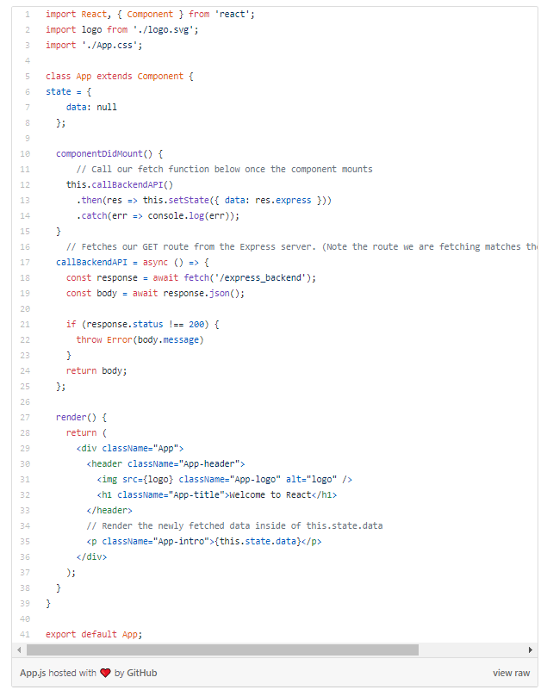
Setup Server (2)
Edit /example123/client/package.json
add to end of json file: “proxy” : “http://localhost:5000/”
Edit /example123/client/src/App.js
componentDidMount() calls callBackendAPI()
Terminal (from example123/)
node server.js
Terminal (from example123/client/)
Npm start

Slide 8
Setup Server (3)
Browser:
Test Back End (NodeJS)
http://localhost:5000/express_backend
Test Front End (React)
http://localhost:3000/

Slide 9
NodeJS / React Development
Back End Development
Express Router: https://expressjs.com/en/guide/routing.html
Documentation: https://nodejs.org/en/docs/
npm install <package-name>
Front End Development
React Router: https://reacttraining.com/react-router/web/guides/quick-start
Documentation: https://reactjs.org/
Have both back-end and front-end on same port
https://stackoverflow.com/questions/48304513/backend-and-frontend-on-same-port

Slide 10
React Development (1)
React is Object Oriented
Classes extend React Components
There are several, React.Component is the basic one
Download open source components

Slide 11
React Development (2)
Render()
Defines html associated with the component
References other react components as tags
E.g. <component-name>
Passes data to other components via properties
E.g. <component-name id={value}>
this.props – A JSON obj of all properties associated with the component
this.state – A JSON obj of all state information, usually only used at the topmost component

Slide 12

React Development (3)
this.setState(jsonObject)
Changes state info for an object as well as automatically updating state of child components
The following code shows how to render the parent React Component
Game is the parent react component to a demo tic-tac-toe game

